Slide 1
Internship Presentation
Vruti Sivakumaran

Slide 2
Outline
Introduction
My Role
The Project
Background Information
The Solution
Final Product
What I Learned

Slide 3
Introduction
Carnegie Mellon University
Electrical and Computer Engineering
Rising Senior
Operations Department
Supervisor: Kevin Wigell

Slide 4
My Role

Slide 5
The Project
Background Information:
7 Wind Farms, 5 Contractor
Maintenance done by Contractors
Reports made when maintenance done
Numerous reports every week

Slide 6
The Project
Background Information:
Maintenance information stored in Computerized Maintenance Management System.

Slide 7
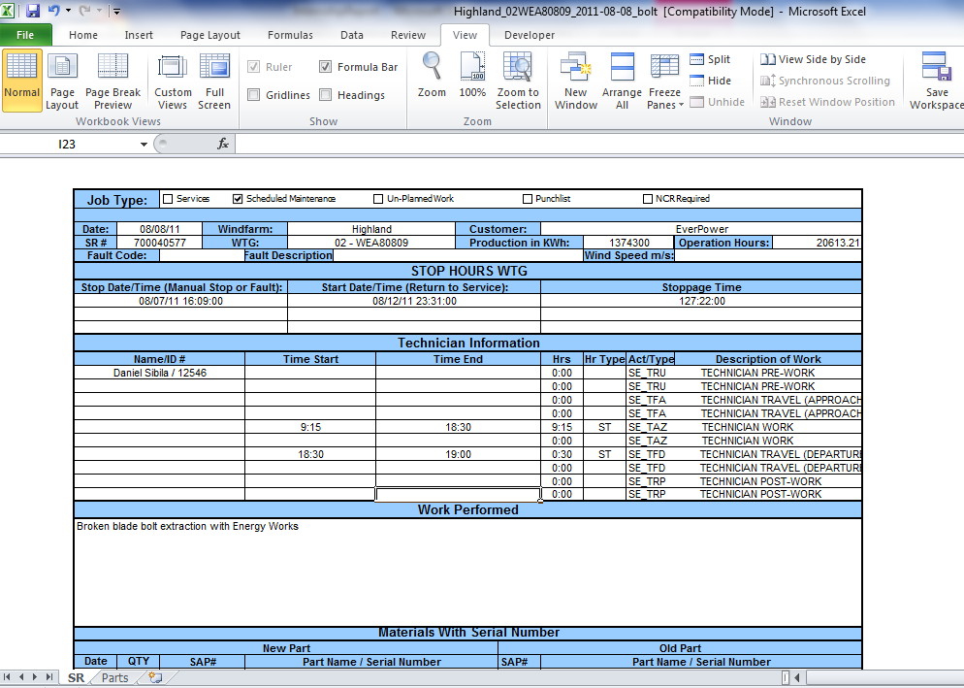
Report Example

Slide 8
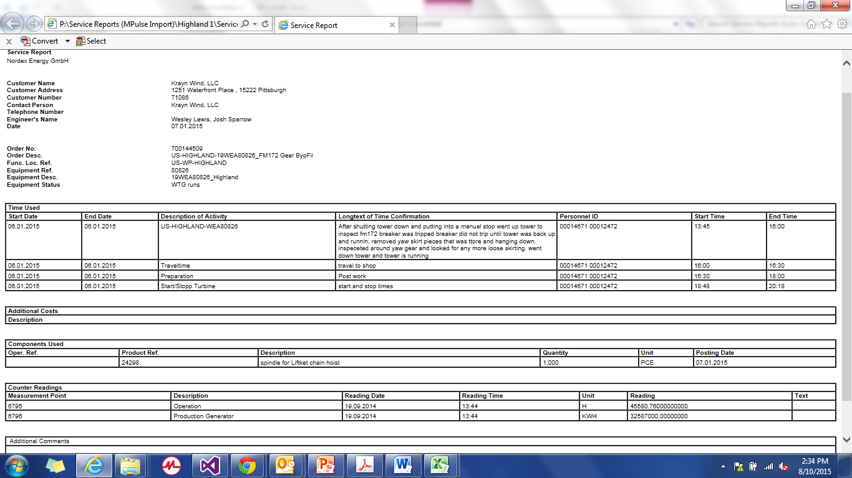
Report Example

Slide 9
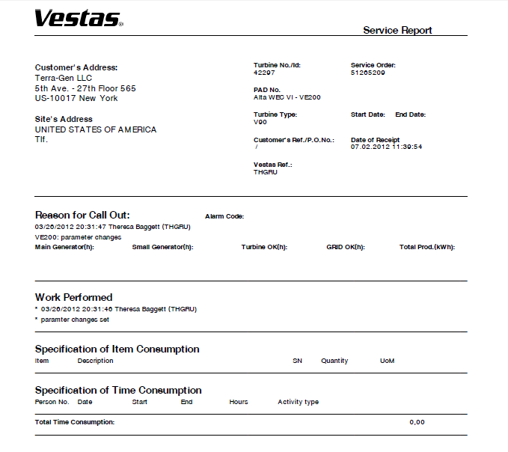
Report Example

Slide 10
The Solution
Specifications

Slide 11
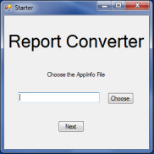
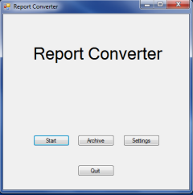
Demonstration

Slide 12
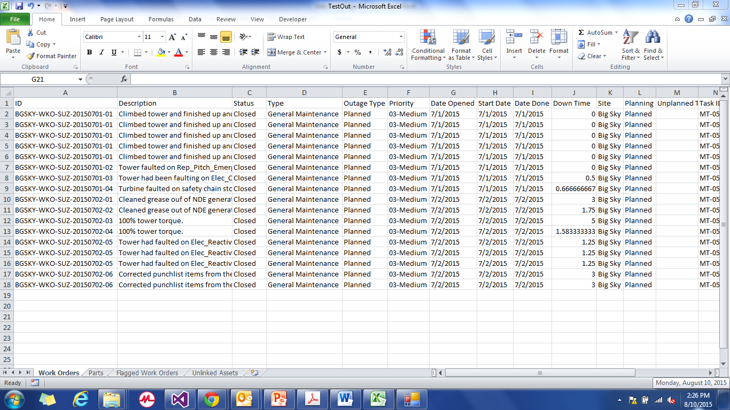
Demonstration

Slide 13
What I learned

